Slide 1
Revision
Visual Basic

Slide 2
Table OF contents
L1 – Visual Basic Introduction
L2 – Data Types and Arrays
L3 – Object Properties and Methods
L4 – Algorithms Planning and Refinement
L5 – Procedures and Arguments (Part 1)
L6 – Procedures and Arguments (Part 2)
L7 – Decisions and Debugging
L8 – Looping Constructs and Iteration

Slide 3
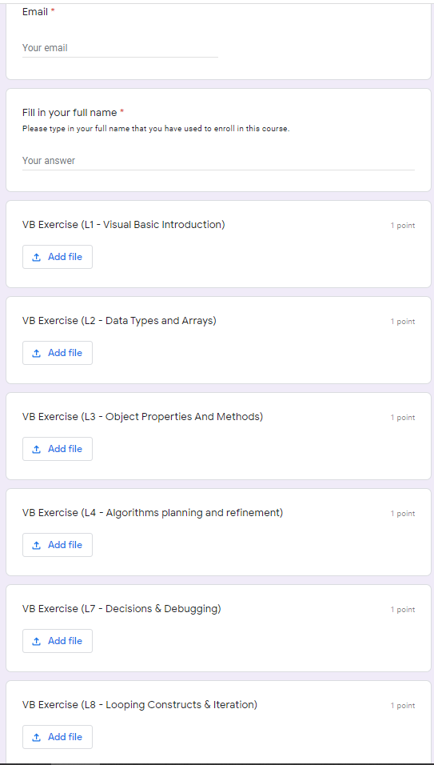
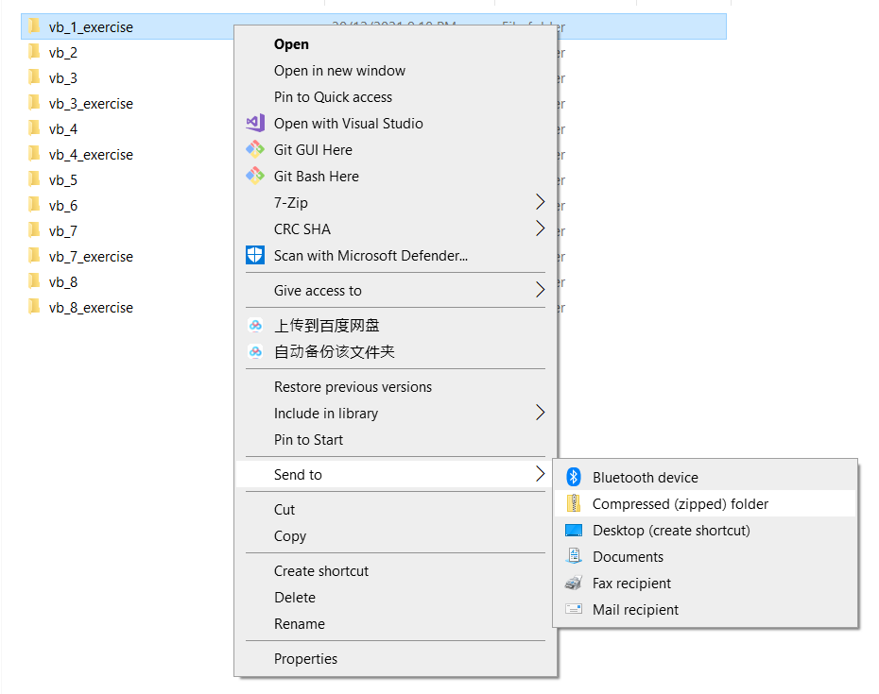

Exercise Submission
Submission Link : https://forms.gle/ZQFrNch4ihhN5aMz6
Zip the Project File
Submit the whole file to the google form

Slide 4
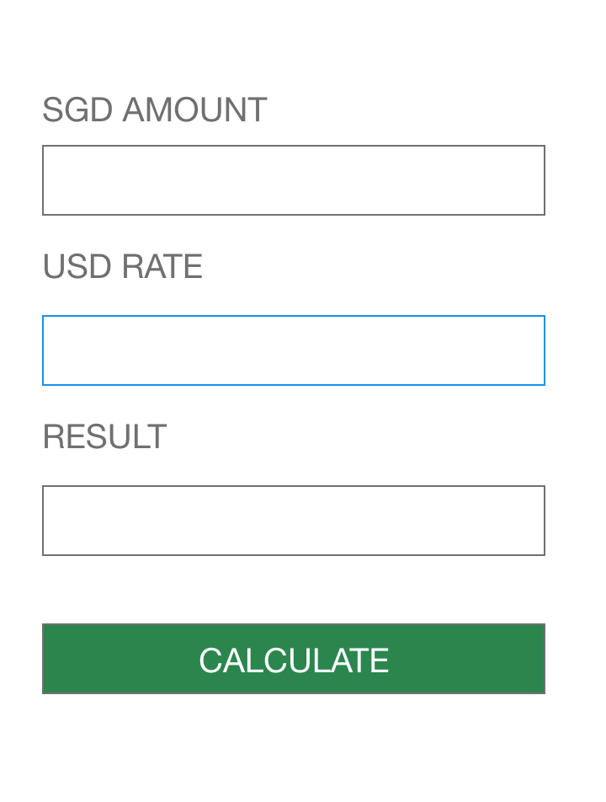
EXERCISE 1 - (10 – 15 MINS)
We are going to practice how to create a User interface.
Only UI is needed, we do not need to program the logic yet.
Get the experience to drag and drop your objects from the toolbox.

Slide 5
Hands on Exercise
We will practice our truth tables
We will use this concept a lot in our work
No | Operations | Outcome
1 | True or True
2 | True or False
3 | True And False
4 | True And True
5 | True or False or True
6 | True And True And False

Slide 6
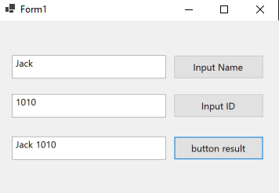
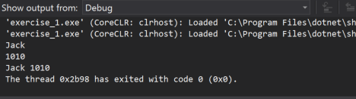
EXERCISE (10 – 15 minutes)
To create a mini application
Input name button on click must print in visual studio output
Input id button on click must print in visual studio output
When I click button result it should print out the name field with a space followed by the ID

Slide 7
Exercise (10 – 15 mins)
Design a Centigrade to Fahrenheit convertor
There is no need to design it vice-versa
Popular exam question to test competency
Formula: Fahrenheit = Centigrade * 9/5+32
Notes:
Must remember by heart these 4 points, though not scope of course, you will consciously and subconsiously use this programming paradigm.

Slide 8
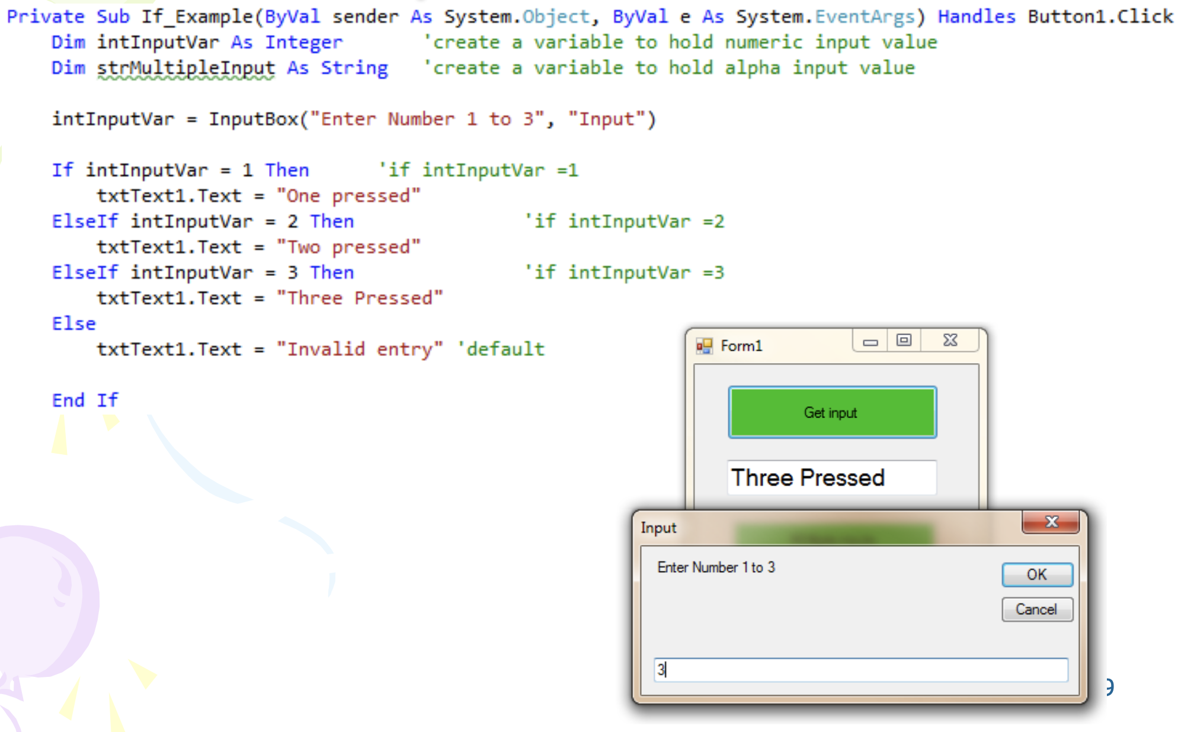
Exercise (10 – 15 mins)
Submit this piece of code for this exercise for this particular chapter
Feel free to expand on this, but minimally your app should have the minimal functionally as shown in the screenshot here

Slide 9
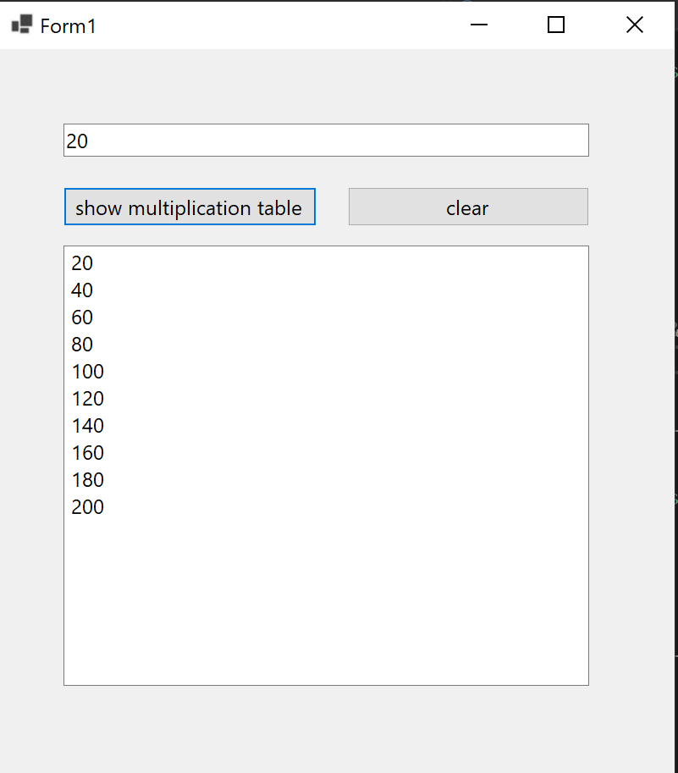
EXERCISE (15 – 20 minutes)
To create a mini application
We are going to create a multiplication table
When I click the multiplication table it should generate the 1st 10 numbers of the multiplication table for this number.
When I click clear it should clear all the values inside the table.
We assume only valid numbers to be added into the textbox.

Slide 10
L1 – Visual Basic Introduction
Visual Basic

Slide 11
Table OF contents
Main Visual Studio IDE Components
Solution Explorer
Toolbox
Designer Window
Code Window
Properties
First Program – Activate Controls (Button)
Clicking Button with Mouse
Click Event Programmatically

Slide 12
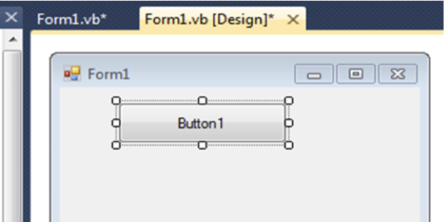
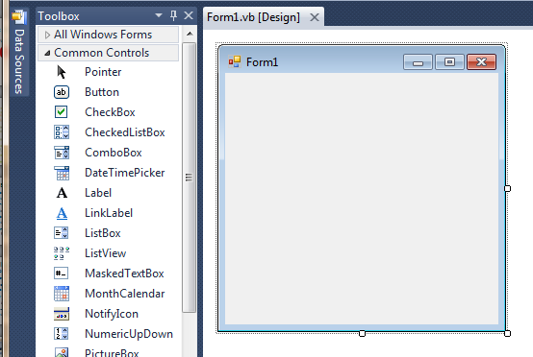
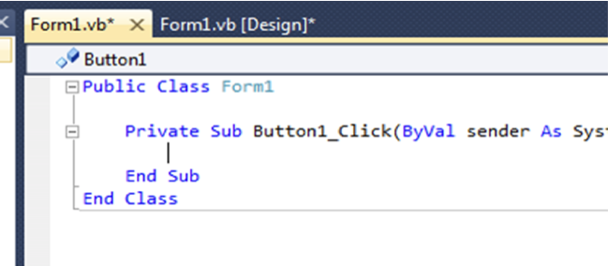
First time use – first program
L1 Slide 14
Your new project screen shows the FORM where the CODE and COMPONENTS will reside
This is the INTERFACE design area
Place a Button on the Form – drag and draw!
2
1
DoubleclickButton to open CODE window, specifically, code for the Button
3
Notes:
Learn how to use the escape buttons to exit the selection, very important in UI design

Slide 13
L2 – Data Types and Arrays
Visual Basic

Slide 14
Table OF contents
Numeric Data Types
Non-numeric Data Types
Truth Table
Variable Scoping
1D Array
Working with Bounds

Slide 15
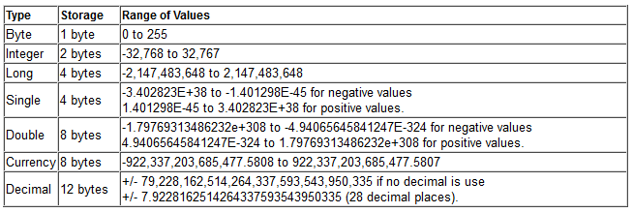
Numeric types
L2 Slide 7
e.g. Dim intLoopCounter as Integer

Slide 16
Non-Numeric types
L2 Slide 8
e.g. Dim myOutcome as String

Slide 17
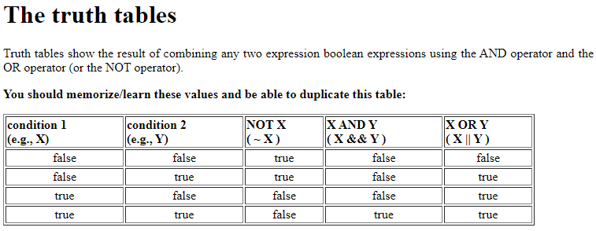
Truth tables
L2 Slide 9
e.g. True And False should return False

Slide 18
Variable scoping
L2 Slide 10
Scope of Procedural declaration is the Procedure – i.e. Private Sub to End Sub
Local variables created at the Dim line and then destroyed at End Sub – re-use resources
Scope of Global declaration is all code across the whole Form – created when program first runs and destroyed when program ends
Procedural declaration
immediately after ‘Private
Sub’ – scope is ONLY the
procedure itself
Global declaration
immediately after ‘Public
Class’ – scope is ALL
procedures on Form Class

Slide 19
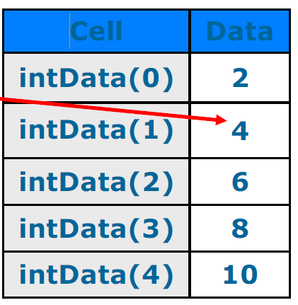
Array visualization
L2 Slide 14
A 1 dimensional array may be visualized as a single spreadsheet column E.g. Dim intData(4) as integer
Contains 5 (4+1) contiguous integer elements
May fill cells with data thus: intData(0)=2, intData(1)=4,
intData(2)=6, intData(3)=8,
intData(4)=10
Dim intData as Integer = {2,4,6,8,10}

Slide 20
Working with bounds
L2 Slide 17
One may work with Upper or Lower Bounds rather than known values: good for dynamic arrays when size is not always known
Use GetUpperBound() or GetLowerBound() Methods to find array size
Use 0 as argument for 1D and 0 or 1 for 2D

Slide 21
L3 – Object Properties and Methods
Visual Basic

Slide 22
Table OF contents
Object Prefixes
Properties & Methods
Events
Form & Controls

Slide 23
Object prefixes
L3 Slide 4
Names must start with a letter (max 255) Capitalise and Prefix object names as follows (assessed):
Prefix | Object | Example use
cbo | Combobox | cboUserChoice
chk | Checkbox | chkUserSelection
cmd | Command Button | cmdStart
dat | Data | datMyDataFile
dir | Directory list | dirUserDirectory
dlg | Common dialog | dlgPrintFile
frm | Form | frmStartupForm
Gr | Graphics Object | grForm
txt | Textbox | txtDataEntryBox
Btn | Button | btnOk

Slide 24
General Programming Understanding
L3 Slide 6
Accessing Properties
picPicture1 is a Class / Object in this example
When u use the dot notation, you are accessing the internal variable inside of it
Writing it in this manner would mean assigning the value to the inner variable
Also known as variables in other programming languages
e.g. picPicture1.BackColor = Color.Red
Accessing Methods
picPicture1 is a Class / Object in this example
When u use the brackets at the end u are trying to access a method
Writing it in this manner would mean assigning the value to external variable
Also known as functions in other programming languages
e.g. myResult = picPicture.getColor()

Slide 25
EVENTS
L3 Slide 10
Trigger an object’s reaction to external or internal stimuli
Windows monitors for events and ‘flags’ occurrence to objects – not instantaneous
Response code = EVENT HANDLER
No Event Handler code= no response
e.g clicking the command button runs: Private Sub Button1_Click(ByVal sender As System.Object, ByVal e As System.EventArgs) Handles Button1.Click
“Button1_Click” is just a name,
“Handles Button1.Click”
defines the event it handles
*Note underlined section beyond scope of the module
Notes:
Some of these concepts may be new to you, so will look through the next few slides to understand further.

Slide 26
FORM OBJECT
L3 Slide 14
Basis for most VB apps.
One may have multiple forms in an application
Supports many events
Most important event handler is under the Load Event - run at application startup - initialization of variables and equipment - similar to onInit on other programming languages

Slide 27
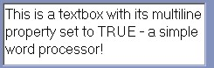
TEXTBOX CONTROL
L3 Slide 15
Gather user input or display program output – most applications use Textboxes
Typical properties: dimensions, position, bold, italic, index (control array), password box (******), colour, scrollbars...
Supports MULTILINE property (default=False)
Notes:
If multiline is true, the textbox can be adjusted

Slide 28
TEXTBOX CONTROL
L3 Slide 16
To display text,
set property
To read and store text, equate a
variable to the object’s property
Private Sub Button1_Click_1(…) Handles Button1.Click
txtTextbox1.Text = “Hello World”
End Sub
Private Sub Button1_Click_1(…) Handles Button1.Click
Dim strMyString as String
strMyString = txtTextbox1.Text
End Sub
Notes:
If multiline is true, the textbox can be adjusted

Slide 29
L4 – Algorithms Planning and Refinement
Visual Basic

Slide 30
Table OF contents
Lecture Context
Flowchart
Modularity
Top Down Design

Slide 31
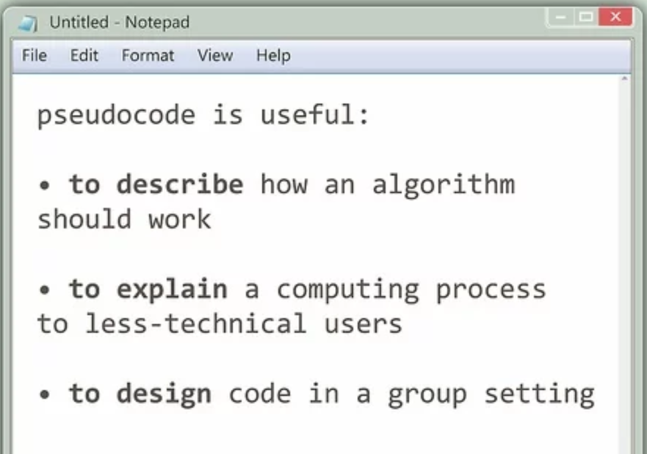
Lecture context
L4 Slide 3
Be familiar with pseudo code and flowcharts
Understand the fundamentals of algorithmic design.
Appreciate the importance of careful planning and modularity
Know how to use top-down and stepwise refinement design techniques
Notes:
Must remember by heart these 4 points, though not scope of course, you will consciously and subconsiously use this programming paradigm.

Slide 32
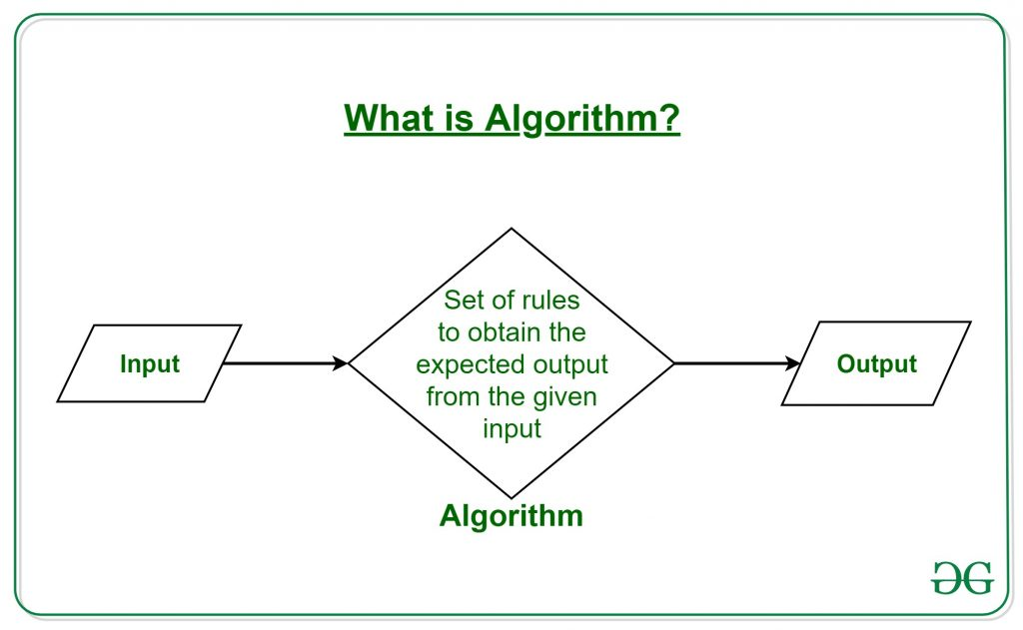
WHAT IS AN ALGORITHM?
L4 Slide 8
A precise set of instructions which specifies exactly how a task is done
Instructions must (nearly) always be carried out in correct sequence
They are always language independent
May often be changed slightly without generating problems – beware, computers do EXACTLY as they are TOLD (not mind readers)
Notes:
Must remember by heart these 4 points, though not scope of course, you will consciously and subconsiously use this programming paradigm.

Slide 33
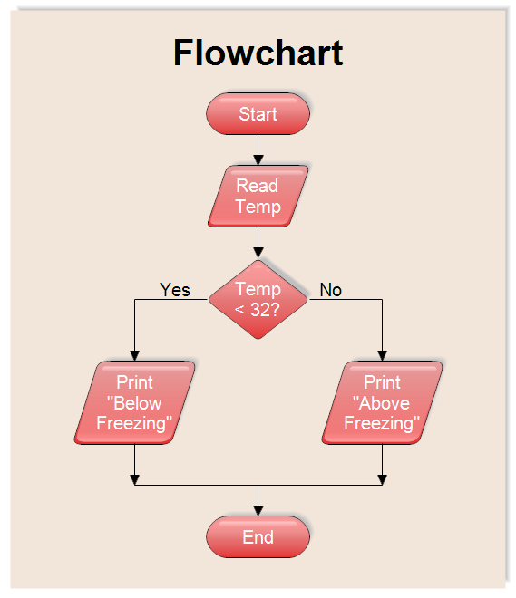
Flowcharting
L4 Slide 9
Some rules before flowcharting
Fully understand the problem
Be clear what information you have and what information you are trying to discover
Pay attention to units and conversions
Draw a picture/sketch if possible to get problem clear in your head
Work backwards sometimes – what is the last step required to get the required answer?
look for repeated operations (iteration)
Notes:
Must remember by heart these 4 points, though not scope of course, you will consciously and subconsiously use this programming paradigm.

Slide 34
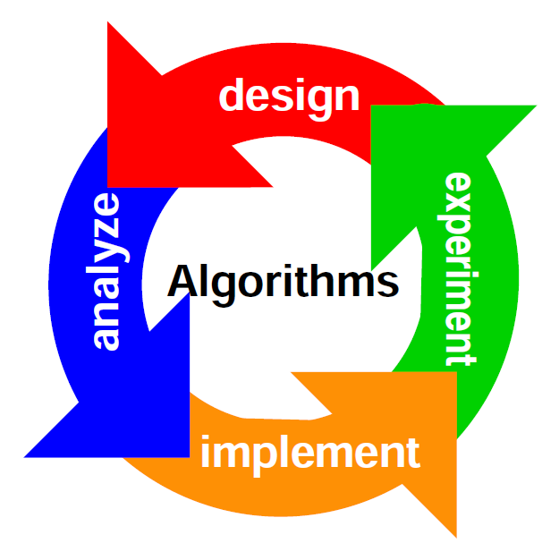
Representing algorithms
L4 Slide 13
Flowchart: clear graphical representation of Algorithm
Pseudocode: Structured English using ‘English-Like’ words to describe algorithm
Flowchart much better for larger designs – but need to break large tasks down
Goal is to produce stepwise refined language-independent, clear process description
Notes:
Must remember by heart these 4 points, though not scope of course, you will consciously and subconsiously use this programming paradigm.

Slide 35

Modularity & structure
L4 Slide 15
Modularity is a VERY important technique
Build algorithm up from small sections: easy flowcharting, programming, testing, and debugging
Split the problem up into small sections and program each as a module (procedures - future lecture)
There are three basic programming structures available for use in our modules: - Sequence - Do this, then this, then this, then…. - Selection - Do this, or this, or this and this, or…. - Iteration - Do this same thing over and over again….
Notes:
Must remember by heart these 4 points, though not scope of course, you will consciously and subconsiously use this programming paradigm.

Slide 36
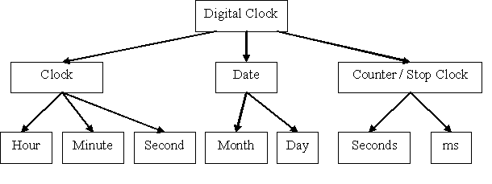
Top-down design
L4 Slide 17
Must fully understanding nature and complexity of the problem first
Initially describe algorithm’s functionality at high level of abstraction using basic, broad, steps
Refine each step individually by adding increasing levels of detail; stepwise refinement
A fully refined design is detailed to a level that requires a simple step to translate into ANY high-level programming language
Good example of a top-down design
Notes:
Must remember by heart these 4 points, though not scope of course, you will consciously and subconsiously use this programming paradigm.

Slide 37
L5 – Procedures and Arguments (Part 1)
Visual Basic

Slide 38
Table OF contents
Variables
Subroutines
ByVal
ByRef

Slide 39
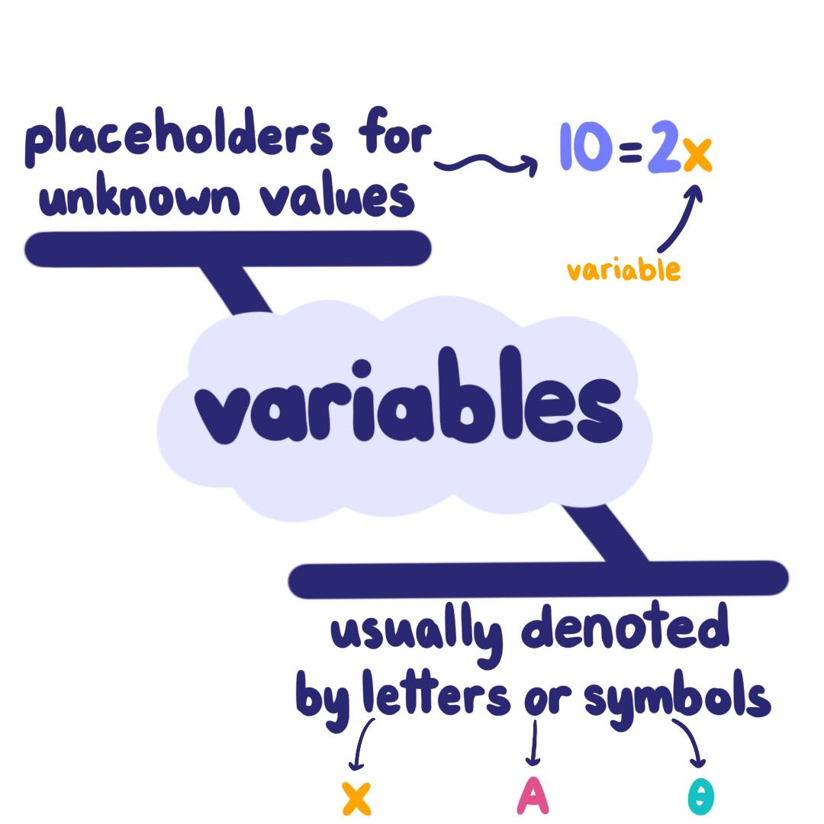
Variables
L5 Slide 4
Create variables (use memory) when needed + destroy (release memory) when not
Manage by grouping and limiting their Scope to Procedure Level
Global variables only used if no other way to share data across modules - never passed!
Procedures should operate only on Private objects / data passed to them

Slide 40
SUBROUTINES
L5 Slide 5
Code within Sub/End Sub statements
private sub name (inputs)
End Sub passes control back to calling program: line after the call is then run
Private Sub DisplayCount()
Dim intCount As Integer
intCount = 1
intCount = intCount +1
txtDisplay.Text = intCount
End Sub

Slide 41
SUBROUTINES
L5 Slide 6
Invocation by name: Call DisplayCount
May pass data into Sub using brackets with ‘Call’ or none without Call command
Call FindSum(23, 34) or FindSum 23, 34
Event handlers are Subs - may be called
Program flow immediately diverted to sub
‘End Sub’ returns program flow to line following the call in original routine
In standard module use Public sub name()
Private Sub DisplayCount()
intCount = intCount +1
txtDisplay.text = intCount
End Sub

Slide 42
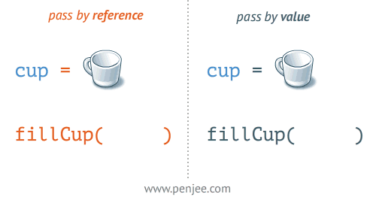
Passing ARGUMENTS BY VALUE
L5 Slide 8
Arguments usually = data (constant or variable)
Passes data values to procedure but does not give the procedure access to their address
Procedure gets copy of original variable contents
If the procedure changes the value, the change affects only the copy and not the variable itself
Use the ByVal keyword to indicate an argument passed ‘by value’

Slide 43

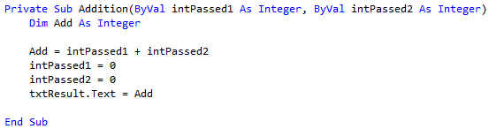
Passing by value example
L5 Slide 9
This Subroutine receives copies of two DATA with no link to original data
These receive and store data for processing
Input variables declared in the brackets

Slide 44
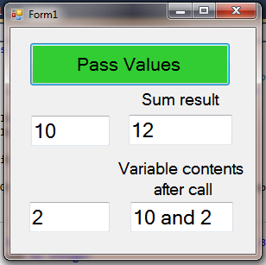
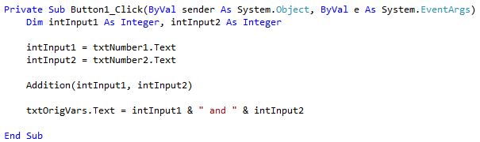
Passing by value example
L5 Slide 10
Passes copy of CONTENTS of intInput1 & intInput 2
After run: intSum = 12 , intInput1 = 10, intInput2 = 2
NOTE No change made to original variables’ contents from inside the calling procedure, only changes are to those variables within the Sub

Slide 45
Passing ARGUMENTS BY Reference
L5 Slide 12
An invoked Procedure given access to original variable’s address in RAM: link to the address
Any changes made to passed argument in the invoked procedure affects the original variable contents too
Data type for an argument passed by reference must match type in the Procedure declaration
Good practice to use different names for data in sending procedure and receiving procedure

Slide 46
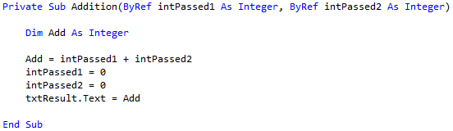
Passing ARGUMENTS BY Reference
L5 Slide 14
This Subroutine receives reference to two ADDRESSES = links to original data
Any changes made to passed argument in the invoked procedure affects the original variable contents too
Data type for an argument passed by reference must match type in the Procedure declaration
Good practice to use different names for data in sending procedure and receiving procedure
put variables declared ByRef which is the only change to the previous ByVal program

Slide 47
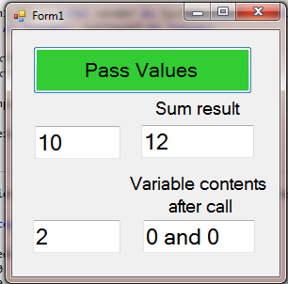
Passing ARGUMENTS BY Reference
L5 Slide 15
Passes ADDRESSES of intInput1 & intInput2
After run: intSum = 12, intInput1 = 0, intInput2 = 0
NOTE original variables’ contents were set to ZERO by the sub routine’s code setting its local variables to zero because of the addresses being passed

Slide 48
L6 – Procedures and Arguments (Part 2)
Visual Basic

Slide 49
Table OF contents
Functions

Slide 50
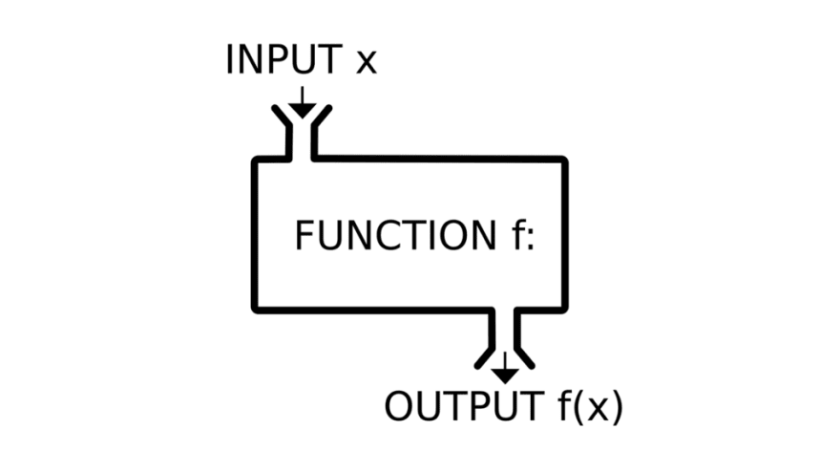
Functions
L6 Slide 4
Code is broken into smaller sections for easier program design, easier debugging and more flexible programming
They are similar to subroutines but can return arguments as well as receiving them as inputs
Function names have data types associated with them (subs do not)
Declaration: Private Function name(inputs)as Type

Slide 51
Functions
L6 Slide 5
As with SubRoutines, we may pass arguments in By Value or By Reference
This (useless) example shows the typical format or ‘shape’ of a Function
Data is returned to the calling procedure using the Return command
Private Function Reduce(ByVal intVal1 as Integer) as Integer
Dim intResult as Integer
intResult = intVal1 - 5
Return(intResult) ‘return what is in the brackets to calling procedure
End Function

Slide 52
Invocation of functions
L6 Slide 6
Invocation different to subs as function returns something that we must store in a variable for further processing
After run, intReturnedResult will contain 23-5, the same value as returned by Reduce Function
Functions can return only a single item (may be
an array or structure)
Data passed into function is ‘local’: variables created as procedure is run – efficient resource use!
intReturnedResult = Reduce(23)

Slide 53
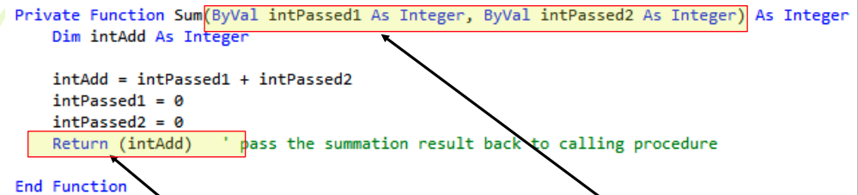
Creating Functions
L6 Slide 8
This Function receives 2 COPIES of original variables’ contents and RETURNS one value
Input variables are declared in the brackets as in a sub routine and receive data (ByVal) or address (ByRef) from the calling routine.
Return value (back to the calling routine) is defined when the Return instruction is encountered

Slide 54
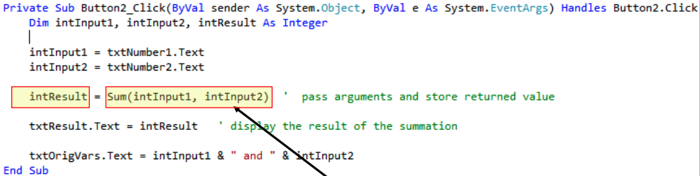
Creating Functions
L6 Slide 9
Passes the intInput1 and intInput2 to the Function after reading from the textboxes
Return value stored in intResult
After the code is run: Sum = 12 and intVal1 = 10, intVal2 = 2 (original variables unchanged when using ByVal in the Function declaration)

Slide 55
L7 – Decisions and Debugging
Visual Basic

Slide 56
Table OF contents
If … Then … ElseIf … Else … End If
Select Case
Debugging

Slide 57
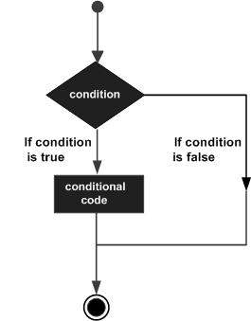
CONDITIONAL DECISIONS
L7 Slide 5
Programs are not always sequential and may need conditional or unconditional branching constructs
Decisions made as a result of comms, calculations, user intervention etc.
Programmers need ways to make their programs flexible and adaptable
Two constructs are common to most programming languages

Slide 58
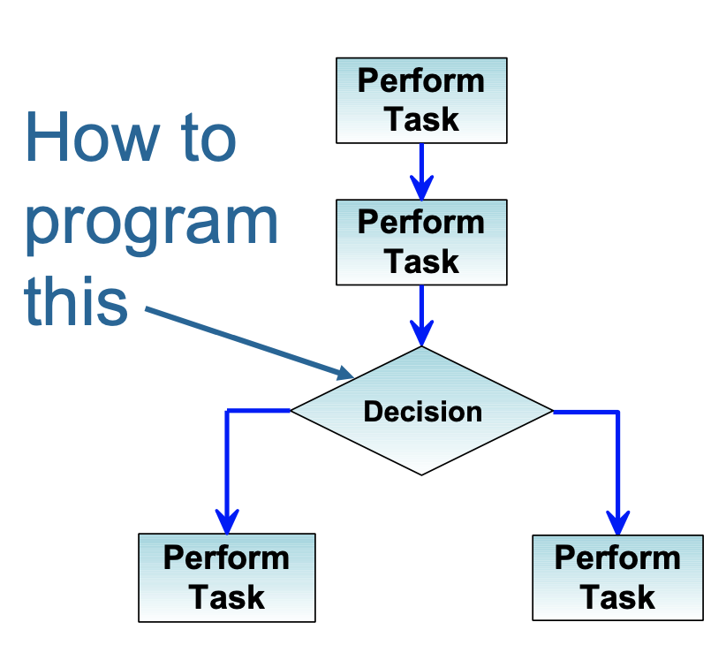
IF then construct
L7 Slide 6
Conditional decisions and control of program flow
Comparison can be x>y, x<y, x = y or x not = y
Often best to avoid ‘=‘
The If-Then construct has
the basic form: If ( test condition) Then
Insert user code here
End If

Slide 59
IF then construct
L7 Slide 8
Able to test for multiple conditions using logical operators
Example 1: If(x=17ANDy=22) Then
Insert user code here
End If
Example 2: If(x = 2 OR x = 3 OR y = 2) Then Insert user code here
End If

Slide 60
Nested IF then construct
L7 Slide 10
May be nested
NOTE: 2 ‘If-Then’ requires 2 ‘End If’ – use comments to track them
intOutput only incremented IF BOTH intInput1 and intInput2 = 1
If intInput1 = 1 then
If intInput2 = 1 Then intOutput = intOutput + 1
End If ‘intInput2 End If ‘intInput1

Slide 61
Code Together example
L7 Slide 11

Slide 62
Alternative to if else
L7 Slide 15
Used as an alternative to a series of If / else
Each ‘expressionlist’ is a list of one or more conditions to be checked
Select Case testexpression Case expressionlist1
[statementblock-1] Case expressionlist2
[statementblock-2].
.....
Case Else
[statementblock-n]
End Select

Slide 63
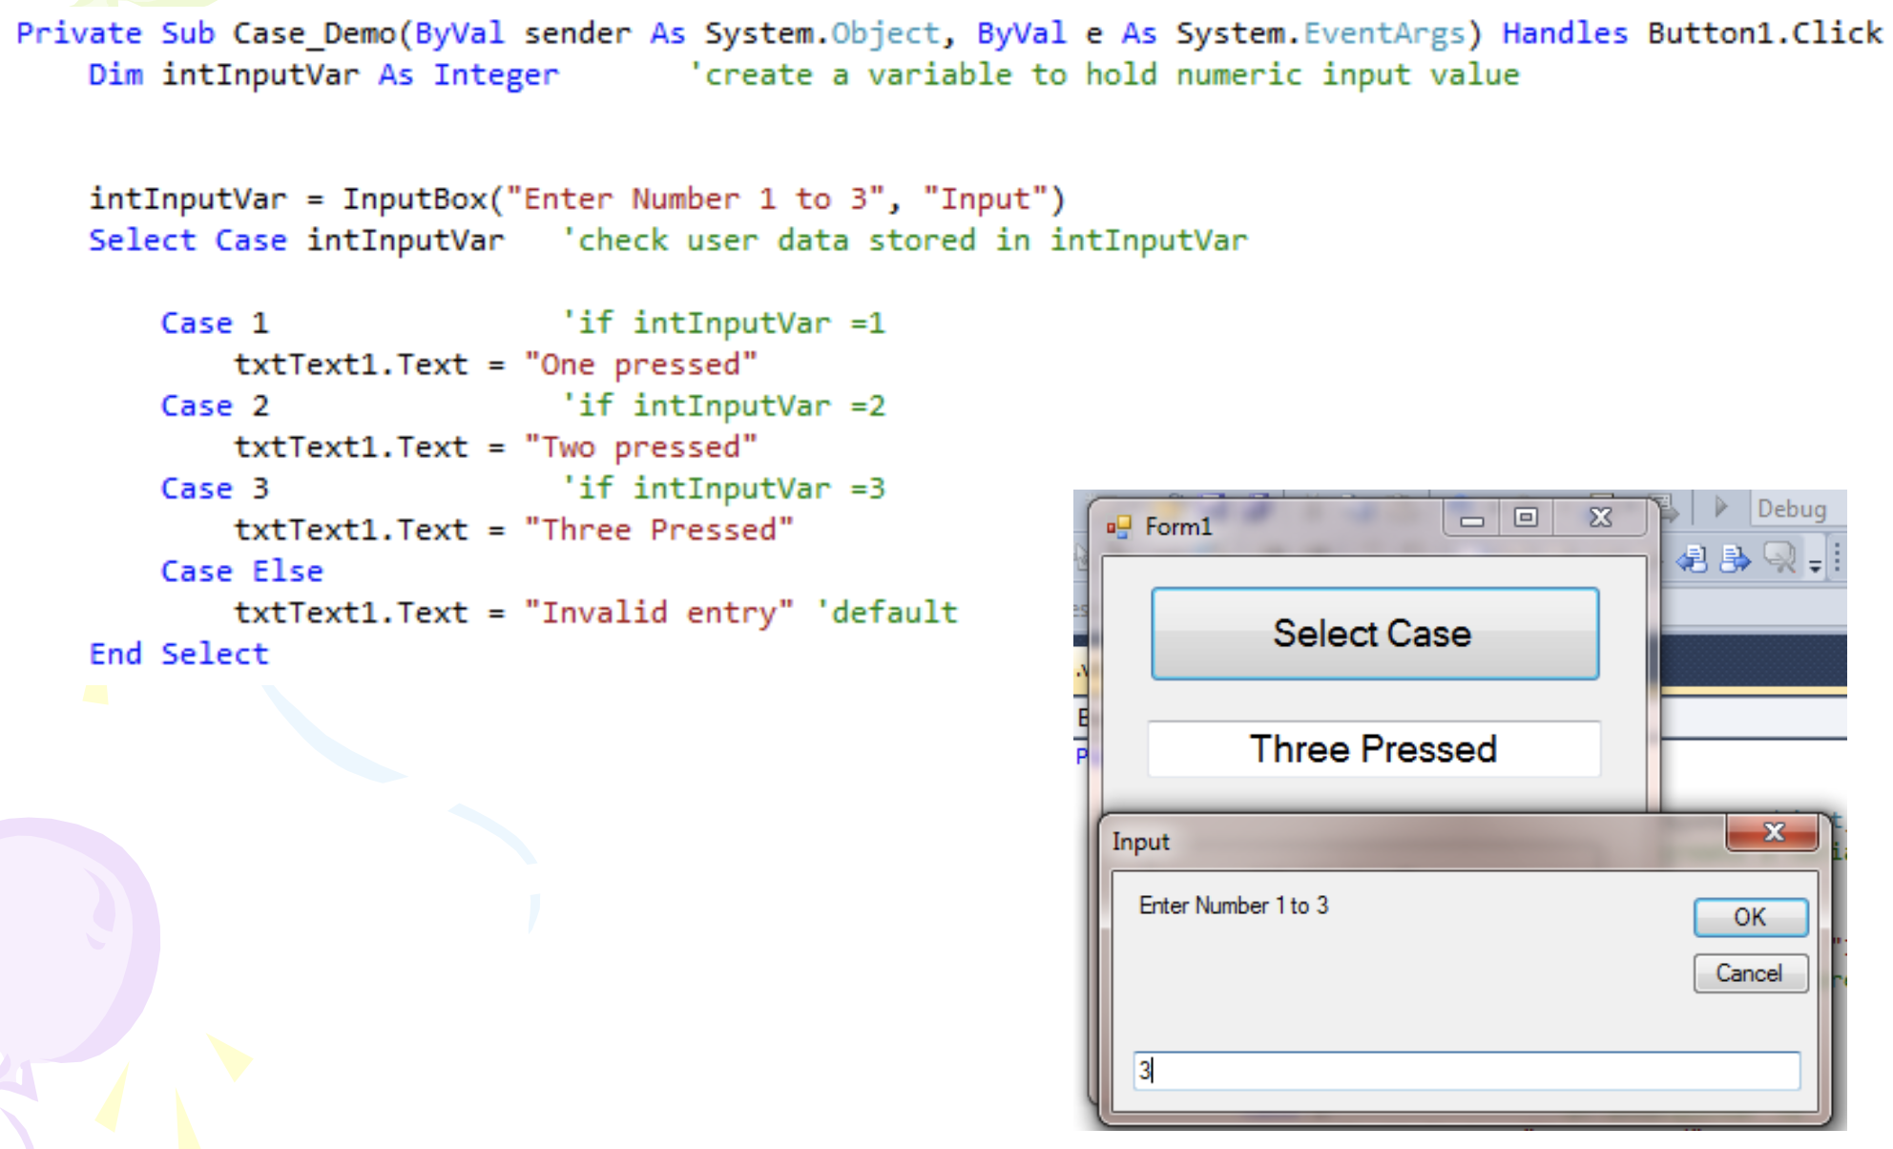
CODE TOGETHER EXAMPLE
L7 Slide 16

Slide 64
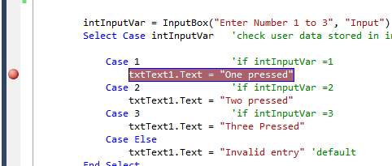
Debugging techniques
L7 Slide 19
These are essential techniques for use when writing code – write small sections and TEST each before moving on
Execution halted with breakpoints
Click to left side of code – line highlighted in red and red dot shown
Code runs line-by- line until breakpoint reached
Similar to other IDE’s like Intellij or visual studio code

Slide 65
L8 – Looping Constructs and Iteration
Visual Basic

Slide 66
Table OF contents
While Loop
Do Loop
For … Next Loop
Nested Loop

Slide 67
While loop
L8 Slide 6
Repeated execution until some condition is met
Comparisons for all constructs x>y, x<y, x=y, x<>y
Begins with While keyword, ends with End While
Test performed before code is run
If condition false before loop entry, code not run
If condition never met in loop then it runs until program is terminated - use exit sub x
While (condition)
Insert user code here
End While ‘go back to start of loop until condition met

Slide 68
While loop
L8 Slide 7
- May prematurely leave the loop if desired using Exit keyword:
- Exit While

Slide 69
do loop
L8 Slide 9
The test is performed at end of the loop
Will always run at least once, even when the condition was met before the code is reached
We may prematurely exit using Exit Do
Begins with the Do keyword and ends with Loop While or Loop Until
Similar to do while loops in other programming languages
Do
Insert user code here Loop While (until) ( test condition met/not met)

Slide 70
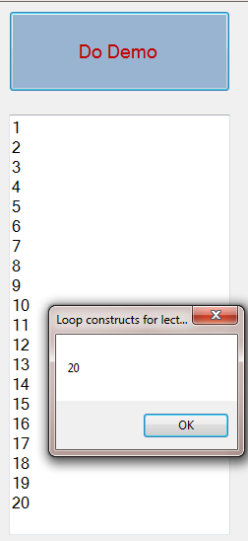
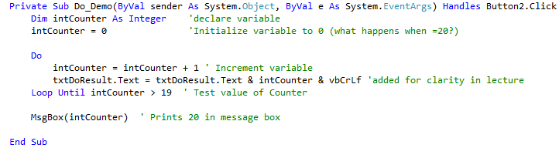
do loop
L8 Slide 10
May prematurely leave the loop if desired using Exit keyword:
Exit Do

Slide 71
For next stepping
L8 Slide 12
To decrement use Step argument with negative values eg. step -1
Step sets size of increment – can be decimals e.g. step 0.1
User code will be run 10 times
For intCounter = 18 to 0 Step -2
Insert user code here
Next

Slide 72
FOR NEXT loop
L8 Slide 13
- May prematurely leave the loop if desired using Exit keyword:
- Exit While

Slide 73
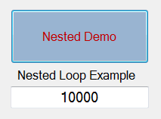
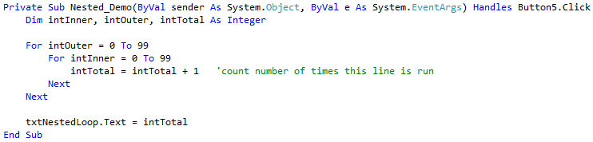
Nested loops
L8 Slide 15
Loops around 100 x 100 = 10,000 times!

